Slide 1
GA submission

Slide 2
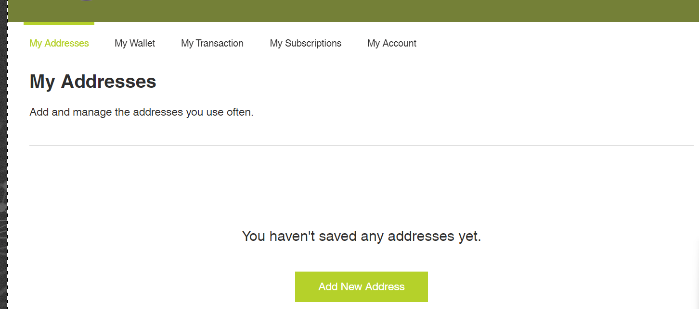
Wix link for home and service page
https://calebng24.wixsite.com/x-money

Slide 3
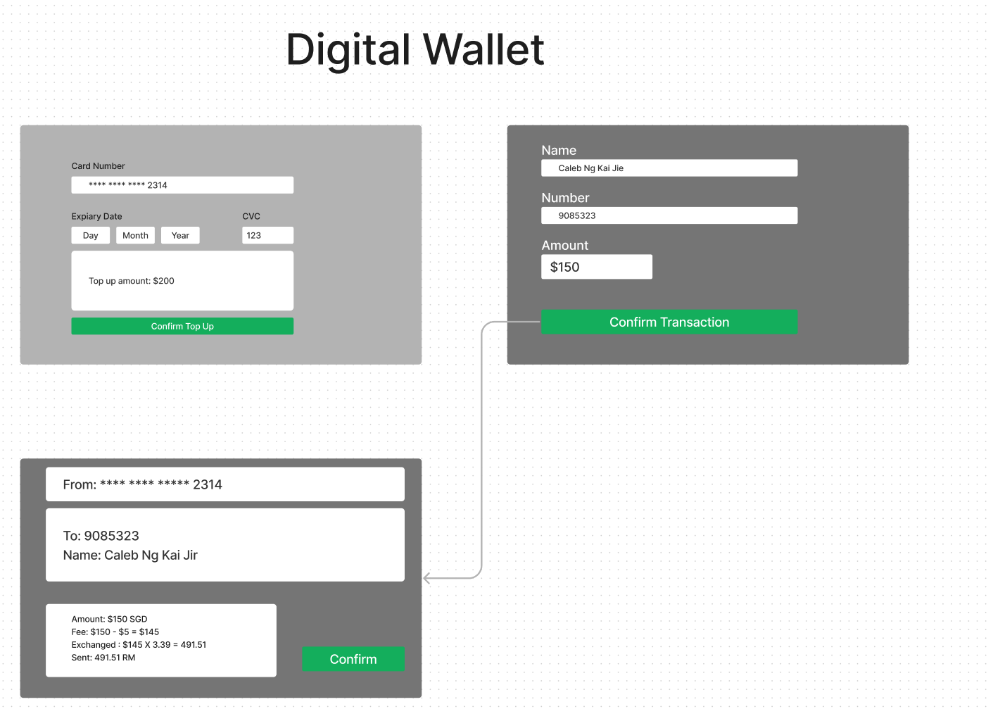

Slide 4
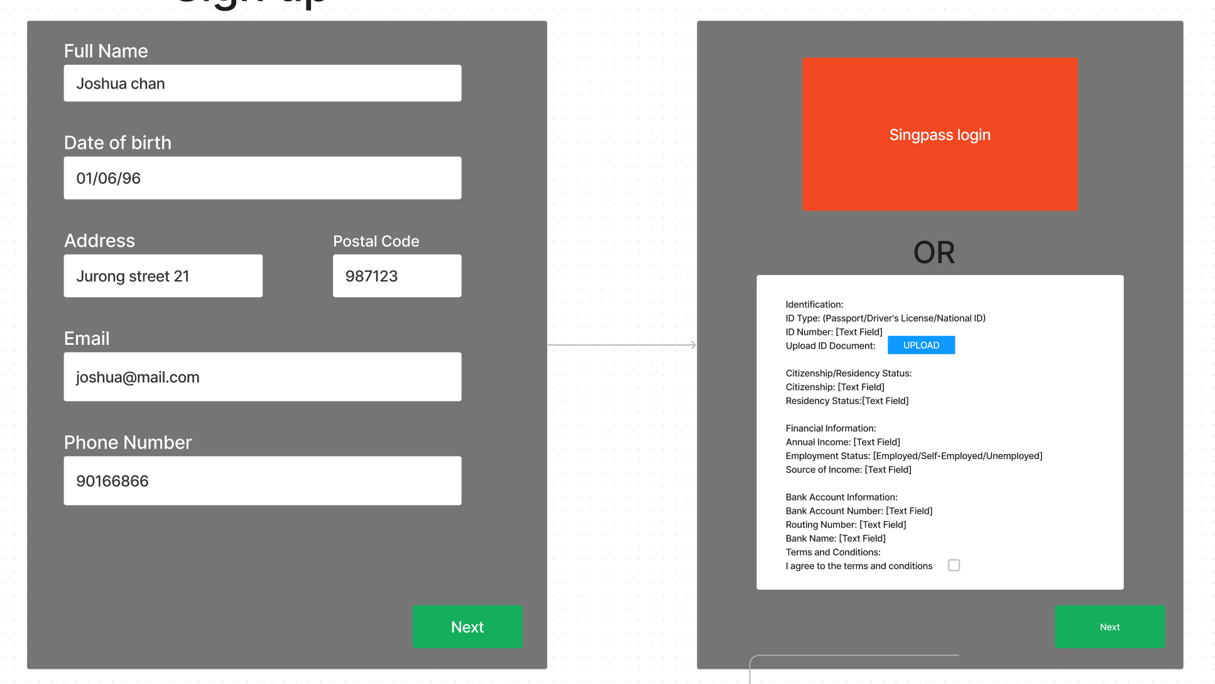
Prepaid debit card set up

Slide 5
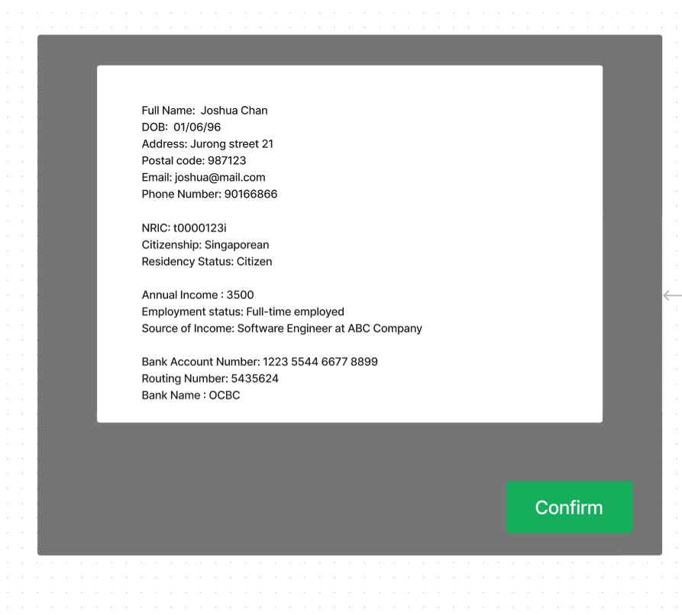

Slide 6
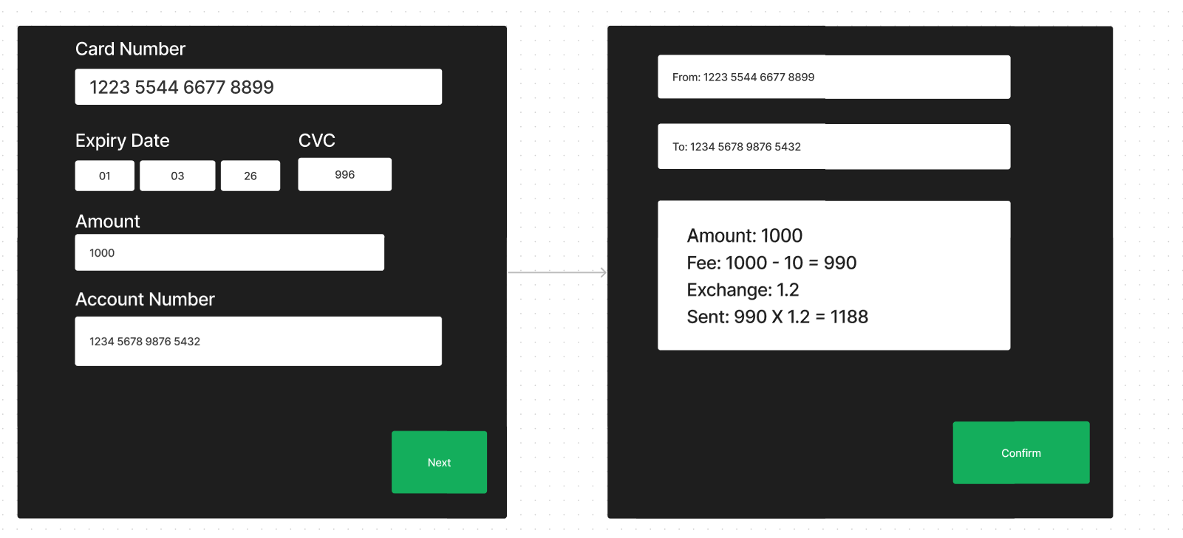
Prepaid debit card transaction

